Slide 1
Supervised Learning Model Performance Metrics

Slide 2
Learning Framework
What
What are Accuracy Metrics
Why
Why do we need to learn about Model Performance Metrics
How
How should we structure our learning of performance metrics?
Key themes related to Model validation
Understand Metric by Metric
Thumb Rules to bear in mind

Slide 3

Model Performance Metrics
What is it?
Why it matters?
These are measures to quantify the working of the Machine Learning Model
These Metrics are a way to ascertain if the model is performing as per expectations or not
The performance metrics provide a feedback methodology to the Data Scientist for further improvement if required
Model Accuracy will be heavily used in evaluation of all Machine Learning Algorithms

Slide 4
Learning Topics – Supervised Learning Metrics
We will go through each of the following topics
Confusion Matrix
Precision | Recall |
F1 Score
ROC and AUC
Gain’s Chart
Gini’s Index
Gini to AUC and Back

Slide 5
How to assess Model Performance
3 Important Questions
What is the Performance on Training Data?
What is the Performance on Test Data?
Are the Performances similar or different?

Slide 6
Confusion Matrix
 |  | Actuals
 |  | Positive | Negative
Model Predicted | Positive | A | B | Predicted Positive Rate | A/(A+B)
 | Negative | C | D | Predicted Negative Rate | D/(C+D)
 |  | Sensitivity | Specificity | Accuracy = (A+D) / (A+B+C+D)
 |  | A/(A+C) | D/(B+D)
Lower is better
Higher is better

Slide 7
Precision , Recall and F1 Score
Precision
 |  | Actuals
 |  | Positive | Negative
Model Predicted | Positive | A | B | Predicted Positive Rate | A/(A+B)
 | Negative | C | D | Predicted Negative Rate | D/(C+D)
 |  | Sensitivity | Specificity | Accuracy = (A+D) / (A+B+C+D)
 |  | A/(A+C) | D/(B+D)
2* Precision*Recall
Recall (True Positive Rate)
F1 Score
Precision + Recall

Slide 8
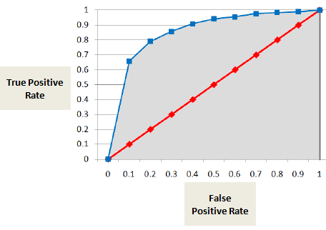
Area under ROC Curve
 |  | Actuals
 |  | Positive | Negative
Model Predicted | Positive | A | B | Predicted Positive Rate | A/(A+B)
 | Negative | C | D | Predicted Negative Rate | D/(C+D)
 |  | Sensitivity | Specificity | Accuracy = (A+D) / (A+B+C+D)
 |  | A/(A+C) | D/(B+D)
Sensitivity
1 - Specificity
X Axis : False Positive Rate
AUC
Y Axis : True Positive Rate
Plot Shows how many mistakes are made by the model before it performs correctly

Slide 9
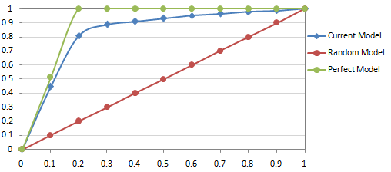
Gains Chart
Gains Chart shows the cumulative capture of events by the model on the Y axis against percentage of population on the X axis
We would like our model to capture as many events as possible within as less population as possible
The perfect model captures all events within 20% of the population
X Axis : How Much Population is Used
Y Axis : How Many Events are Captured
% Events (Target =1)
Area between Current Model and Random
Gains Chart Performance Metric =
Area between Perfect Model and Random
% Population

Slide 10
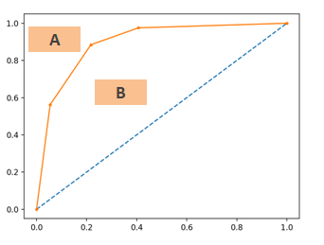
Gini’s Index
Gini’s Index quantifies how well the model classifies Events vs Non-Events as compared to Random Model
It is interpreted as % of Events that are automatically impacted if we take action on x% of the Non- Events
% Events (Target =1)
Gini’s Index = B / (A + B)
% Non-Events (Target=0)

Slide 11
Gini’s Index and AUC
What is the relationship between Gini’s Index and AUC or Area under ROC Curve ?
Gini’s Index = 2 * AUC -1
How ? Let’s find out !
AUC = B + 0.5
B = AUC – 0.5
% Events (Target =1)
Gini’s Index = B / (A + B)
Gini’s Index = B / 0.5
2 * Gini’s Index = AUC – 0.5
Gini’s Index = 2 * AUC -1
% Non-Events (Target=0)

Slide 12
Points To Remember
Always aim for strong performance in both Train and Testing Data
Try to have a model that shows similar (yet strong) performance in Both Train and Test data
Gini’s Index of 70% and AUC 85% are considered be strong model performances, however you should try to improve further is possible

